Slide 1
A Computer Aided Design Tool for NISQ Logic Synthesis
supporting application specific quantum information, communications, and sensing circuit designs
Albert Barron Dinkins V | 11.21.2023

Slide 2
Quantum Computing in the context of Computer Aided Design
What can CAD do for NISQ Computing?
An examination of existing CAD tools for Quantum Logic
Overview of building a CAD tool for Quantum Logic Design
Introduction of the CAD Tool for NISQ Logic Synthesis
Quantum Conventional Logic Design Space
The Purpose of the QCLDS
Building the QCLDS
Creating a Quantum Circuit with the QCLDS
Photonic Logical Design Space
The Purpose of the PLDS
Building the PLDS
Creating a Quantum Optical Circuit with the PLDS
Future Work

Slide 3
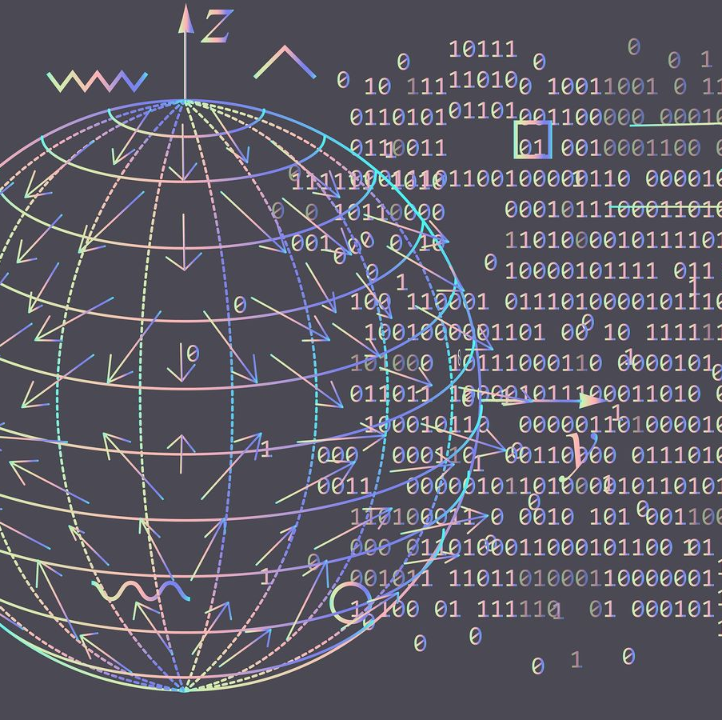
Importance of Computer Aided Design (CAD) for Noisy Intermediate Scale Quantum (NISQ) Devices
If our goal is to build a quantum information network, communication system, or sensing device – we must start at the design of the quantum circuit
Designing quantum circuits over classical circuits is nontrivial
Quantum computations return a distribution of classical results
Quantum circuits can grow very large
Entanglement and Superposition contribute to the cascading of error

Slide 4
Importance of CAD for NISQ Devices Cont.
CAD for NISQ computing is cost efficient
Saves Physical Material, Energy, Time, & Money
CAD offers complete control over parameters
Enables designs tailored to one’s own lab environment
CAD allows an iterative design process
Materials may be limited and only one prototype can be developed at a time

Slide 5
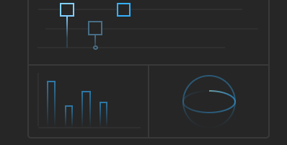
The Current State of CAD for Quantum Computing
X
T
H
CAD plays an important role in the design of analog circuits and 3D objects today
Quantum circuit design uniquely requires the harnessing of quantum physics to operate
Quantum circuits can be modeled using gate diagrams
Provides a clear visual representation
Several quantum circuit designers use this convention
Current Quantum CAD tools, libraries, and simulators:
Strawberry Fields, IBM Quantum Composer, SQUANCH & QuISP
X
H
Z

Slide 6
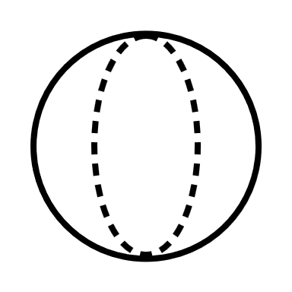
What’s new?
An algorithm-driven design space and a custom visualization model for quantum optical communications processing

Slide 7
The CAD Tool for NISQ Logic Synthesis: CADTQL
H
P
H
S
X
Z
X
T
X
I
Feature 1: The Quantum Conventional Design Space (QCLDS)
Establishes a simple and seamless design process for quantum logic
Expands the usability of IBM Quantum Composer
Builds groundwork for future development in the Photonic Logical Design Space (PLDS)
Brings educational and experimental value to building quantum circuits
Introduces new features like parameterized error, simplified Bell-State (EPR Pair) creation, and automatic full circuit measurement
Promotes an algorithm-driven, as opposed to gate-driven, design space
Parameterized Algorithms: Alleviating the tediousness of developing from scratch
Overcoming depreciated existing implementations

Slide 8
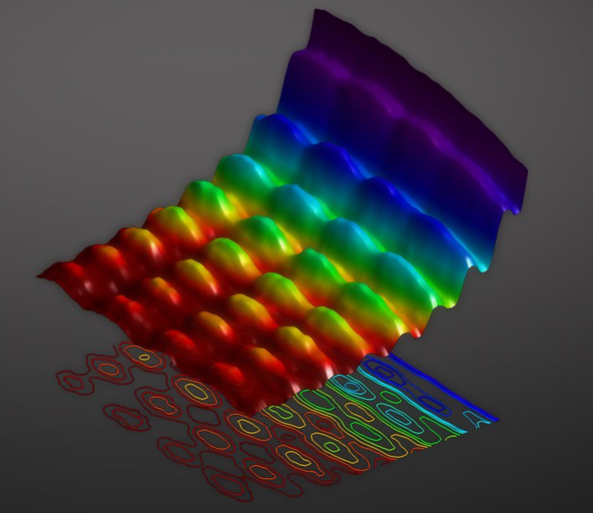
The CAD Tool for NISQ Logic Synthesis: CADTQL
Feature 2: The Photonic Logical Design Space
Takes into account physical hardware parameters
We start with optics for its relation to communications
Can expand to consider trapped ion or superconducting technologies
Allows custom error models related to the physical devices
Permits users to design Application Specific Circuits based on physical optical hardware components
Efficiently and properly simulates all designs
Supports eventual physical construction of a real quantum optical device
[1]

Slide 9
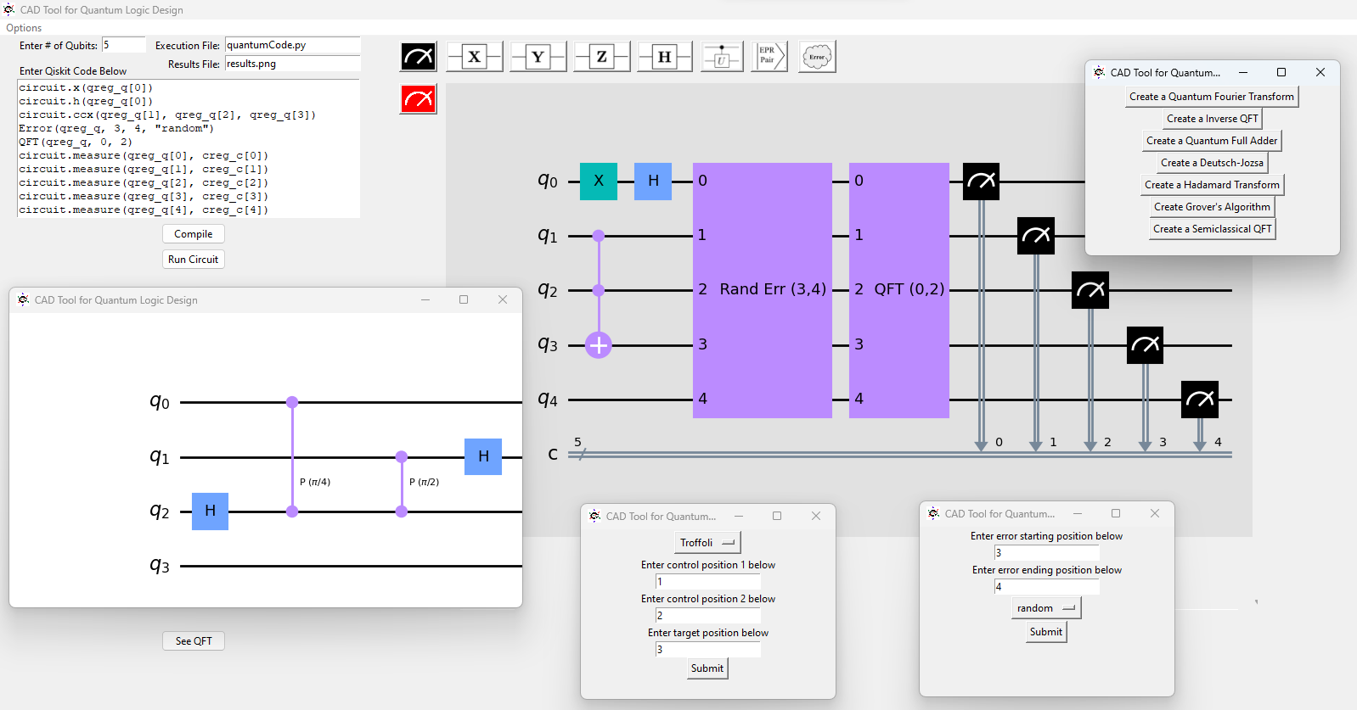
The Quantum Conventional Logical Design Space

Slide 10
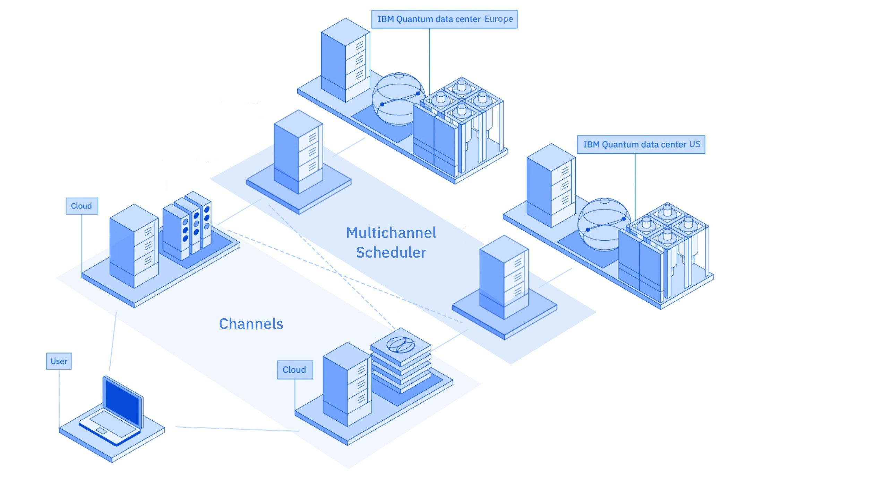
Building the QCLDS
< / >
Classical computers cannot efficiently simulate quantum mechanics
Contains a communications protocol using Qiskit to
Communicate with quantum computer/simulator
Visualize circuitry
Leverages Basic Aer Simulators to execute quantum circuits
IBM Quantum Data Center in Europe [2]

Slide 11
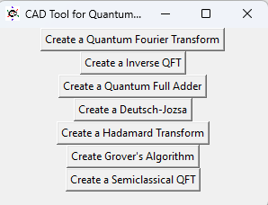
Building an Algorithm Driven Design Space
Qiskit has several algorithms already defined, but their definitions are complex or depreciated
Existing design tools can be improved become more algorithm-intensive
We developed parameterized versions of Deustch-Jozsa, Grover’s Algorithm, the Quantum Fourier Transform and its inverse, and a Quantum Full Adder
Configured CADTQL to require less coding from designer
Buttons, tooltips, pop-up windows, text boxes (TKinter UI)
File management
Quantum Algorithms as parameterized function calls
Integrated display of quantum computation results

Slide 12
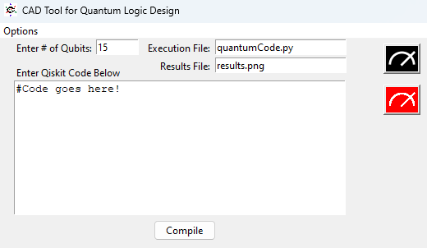
Creating a Logical NISQ Circuit in the QCLDS
Set number of Qubits
Designate the results and execution files
Determine whether to add measurement
Access all standard Python & Qiskit library calls
Access all “Parameterized Algorithms” offered by the CADTQL
In the presence of measurement, circuits can be executed
Designers can always compile their circuit into a visual diagram

Slide 13
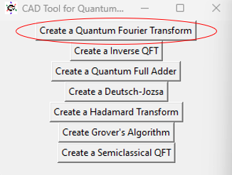
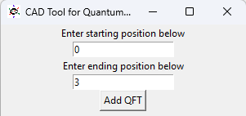
Implementing Conventional NISQ Algorithms
The designer is then prompted with a list of possible algorithm choices
After choosing to create a QFT, the designer is prompted for the necessary parameters
Designer opens the “Options” menu and selects “Add Algorithm”

Slide 14
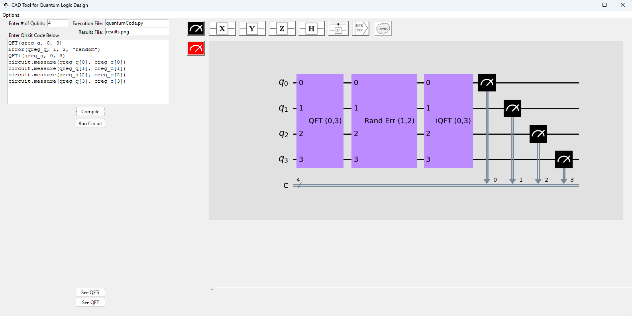
After adding a QFT, the designer can also add error (green) and automatic full circuit measurement (red)
After compiling with measurement, the circuit can be executed for results (blue) and the algorithm “black boxes” can be inspected (purple)

Slide 15
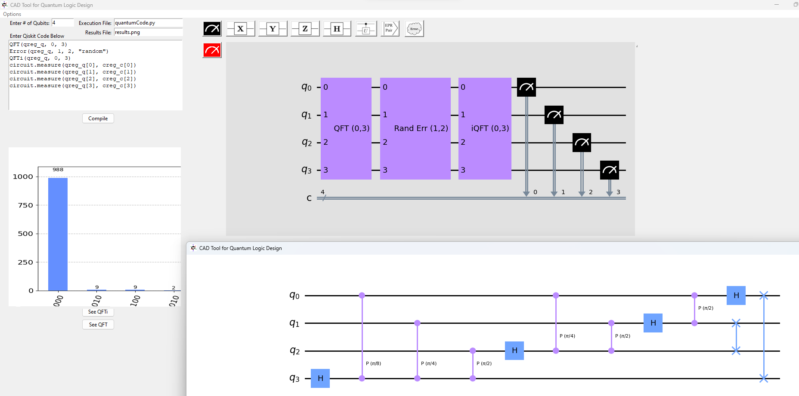
Running the circuit displays a results histogram (left) and clicking “see QFT” presents an inspection window (bottom right)

Slide 16
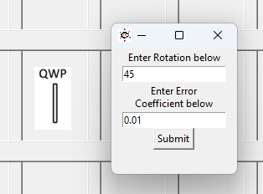
The Photonic Logical Design Space (PLDS)
Focuses on Quantum-Optical implementations
Enables simulations of Application Specific Quantum Devices
Quantum Phase Estimation algorithm in a communications receiver
Novel optical diagramming that employs Gate Based Model
Simulations that consider underlying hardware parameters
The ability to dictate error coefficients to fit specific hardware

Slide 17
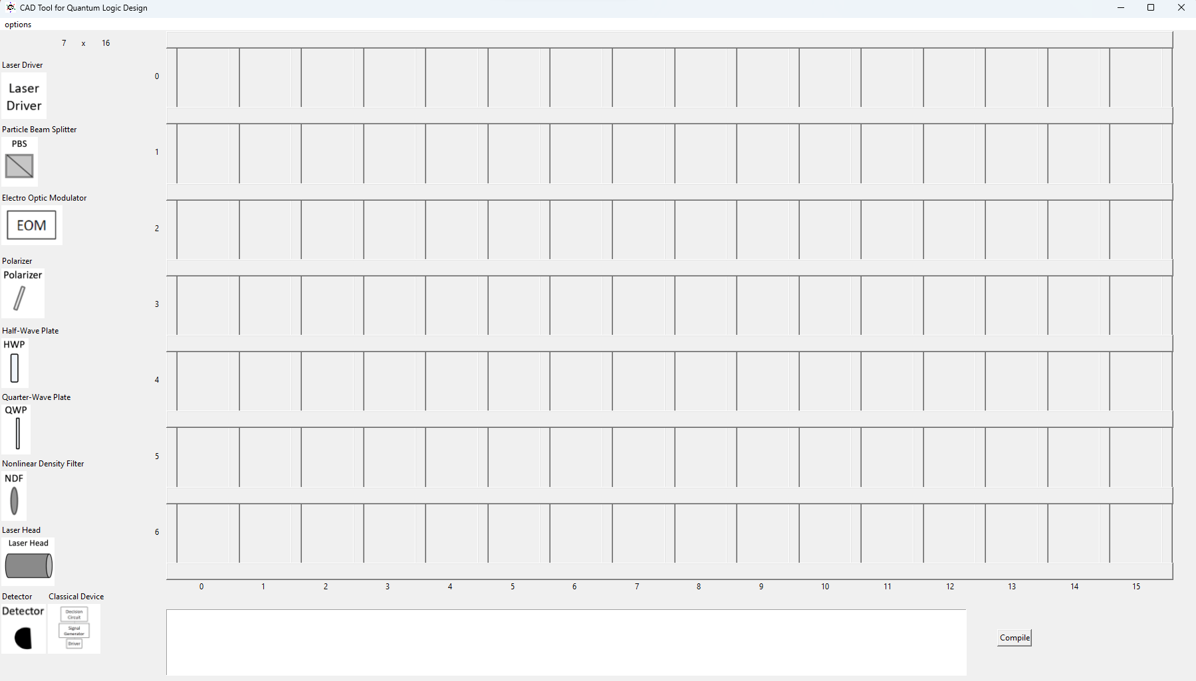
A sample frame of the Photonic Logical Design Space. The custom diagrams and their labels exist on the left-hand side of the screen while, below, a text entry box exists to capture the custom optical assembly code statements associated with each physical device

Slide 18
The Purpose of the Photonic Logical Design Space
Need a design tool for hardware-based implementations
Need simulations that depend on physical parameters
We integrate physical parameters into simulations while designers work with real quantum optical devices
Enabling design of a circuit with their physically available devices
Designers shouldn’t have to worry about the conversion between physical device and quantum effect

Slide 19
Ultimate Goal of the PLDS
To support the realistic design of application specific communication, networking, and remote sensing quantum devices

Slide 20
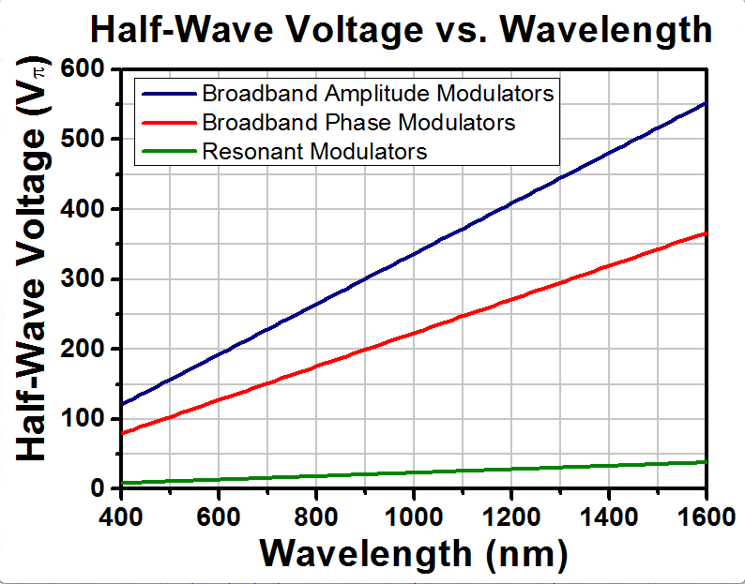
Optical Hardware Considerations
Laser Driver – Repetition Frequency (kHz)
Laser Head – Light Frequency (nm)
Electro-Optic Modulator – Halfwave voltage (Volts)
Polarizer, Half-Wave & Quarter-Wave Plates – Rotation Angle (Degrees)
Non-Linear Density Filter – Optical Density (O.D.)
Particle Beam Splitter & Detector – Quantum Efficiency (%)
Classical Devices (decision circuits & signal generators)
For now, assumed to be 100% effective
An example of some additional information included in one of the tooltips in the PLDS to assist with parameter specification. [3]

Slide 21
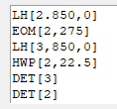
Building the PLDS for Optical Quantum Logic
Class definition for a Particle Beam splitter
Particle Beam Splitter and detectors
PLDS Optical Custom Code sample
Section of the PLDS for setting the circuit board
Custom diagrams representing physical devices
A circuit board for configuring physical device diagrams
Software classes to represent the physical devices and their quantum effects
A coding format capable of articulating physical device parameters
Data structures to store the circuit’s instructions
Effective simulations of the physical devices
Integrated capabilities dependent on results distributions
Phase estimation via FPGA

Slide 22
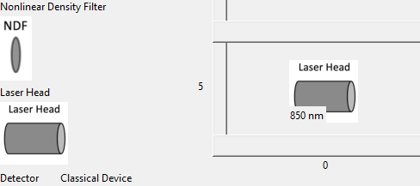
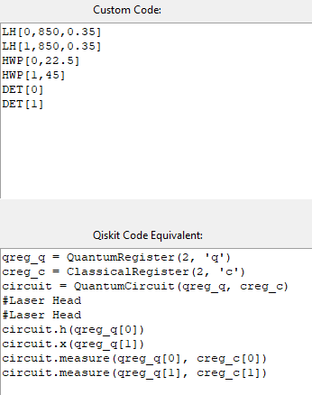
Using the PLDS
Create a “Circuit Grid”
Minimum 1x2, Max 9x16
Drag and drop hardware device diagrams
Input necessary data to enable a specific device
A laser head has light frequency (nm)
Electro-Optic Modulator has halfwave voltage
Compile circuit into an optical assembly code
Similar structure to OpenQasm
Execute converted optical assembly code that accounts for each device’s error model

Slide 23
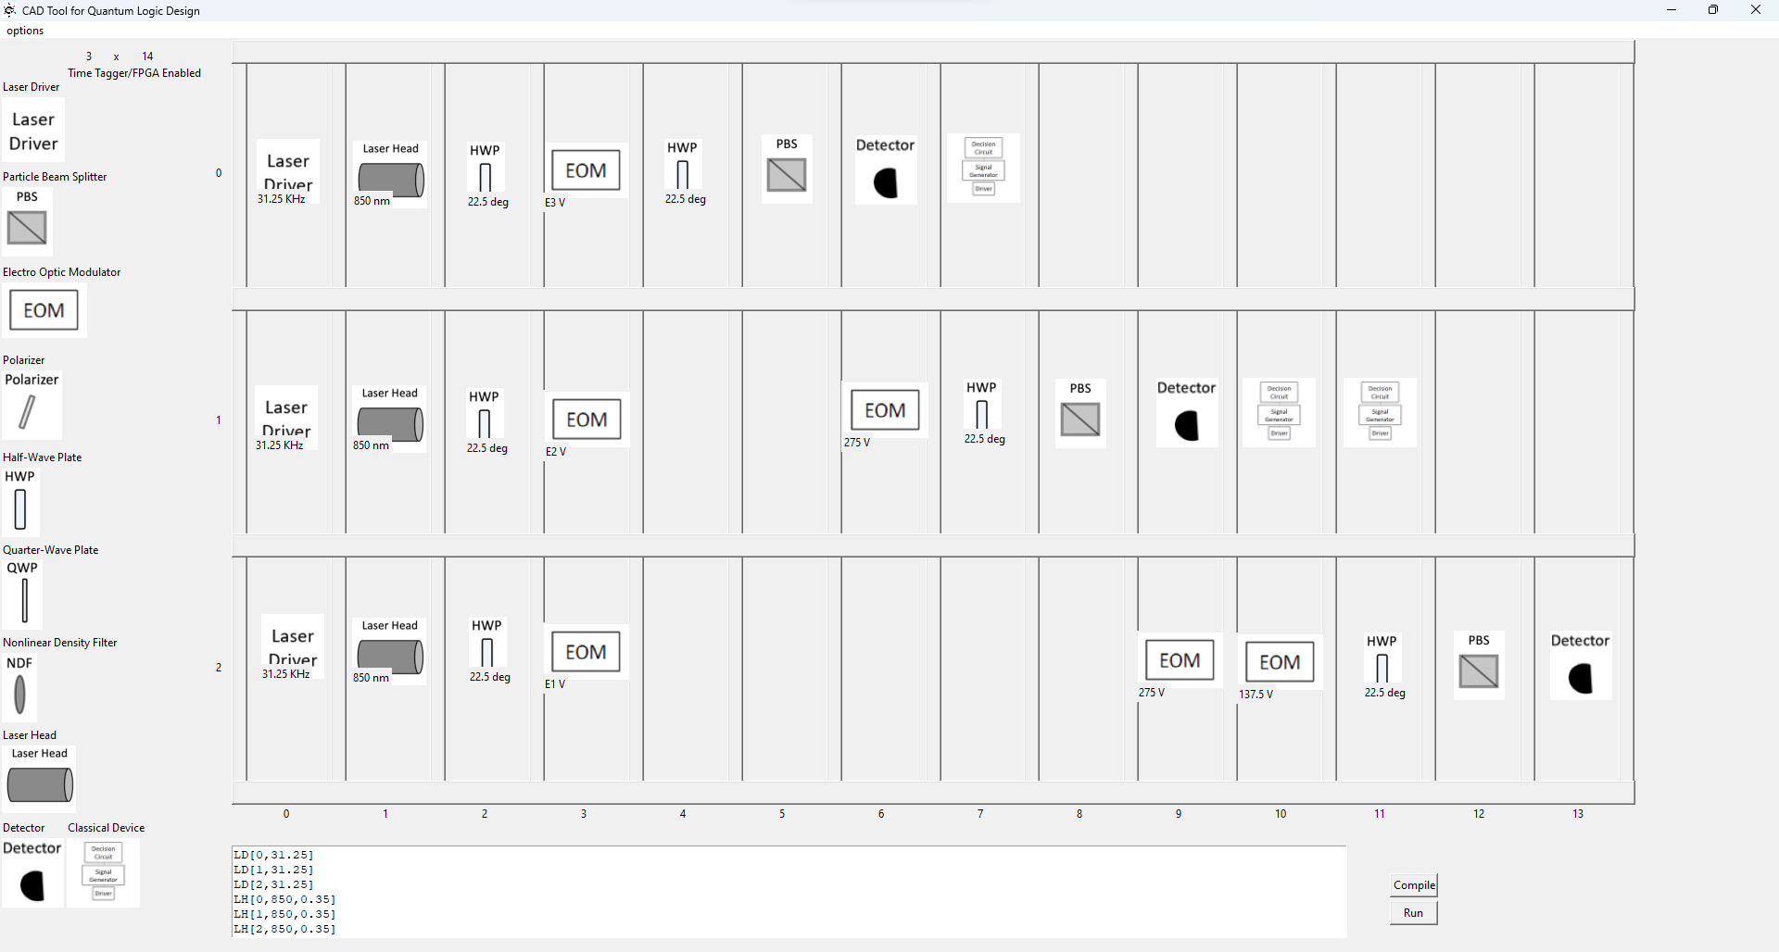
Using the PLDS to Build an Errorless sQFT
A designer has created their own version of the semi-classical QFT via dragging and dropping different physical components into the circuit. Any time a physical parameter is necessary, a pop-up window will prompt the user to input their own specifications.

Slide 24
Once the circuit is compiled and the tool sees measurement, the designer now has the ability to “run” the circuit

Slide 25
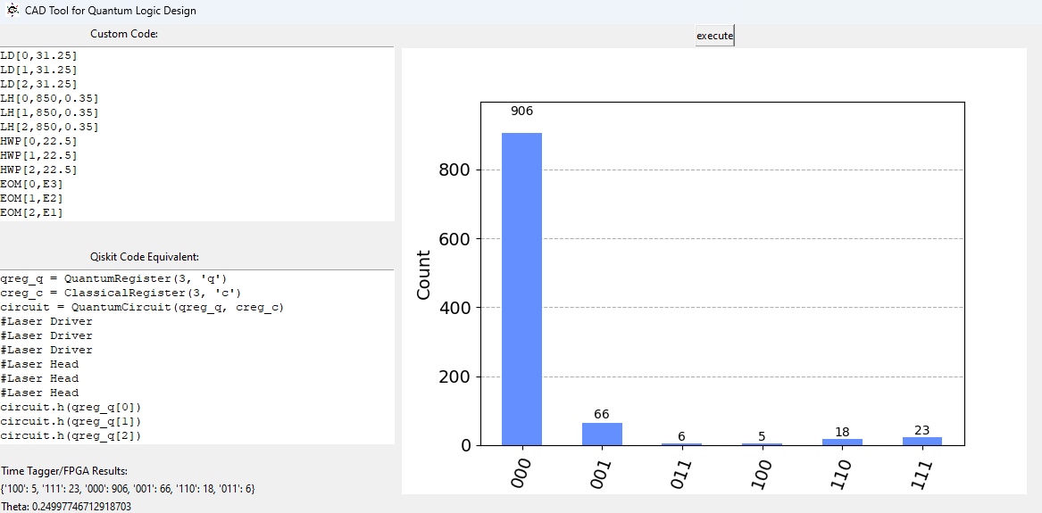
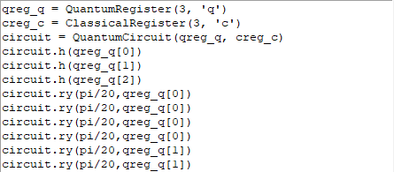
Right: The errorless Qiskit equivalent of the semiclassical QFT built and compiled by the designer
Left: A sample frame of the UI presented to the designer when they click “run”, causing the results histogram to populate the UI.

Slide 26
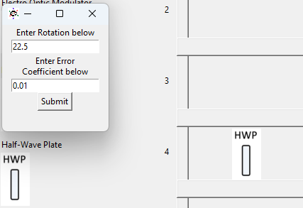
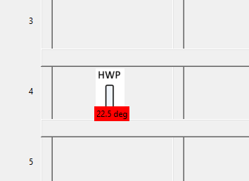
A closer look at Custom error in the PLDS
Marked red, signifying that the device is “errored”
Custom code: HWP[4,22.5]
(custom code is always the same errored or not)
A designer drags and drops a Halfwave plate, after which the application prompts the designer for necessary input

Slide 27
Non-Errored Halfwave Plate rotated by 45 degrees (X gate)
Halfwave plate rotated by 45 degrees (X Gate) Errored by 1%
Small angle error induced by an error coefficient of 0.01

Slide 28
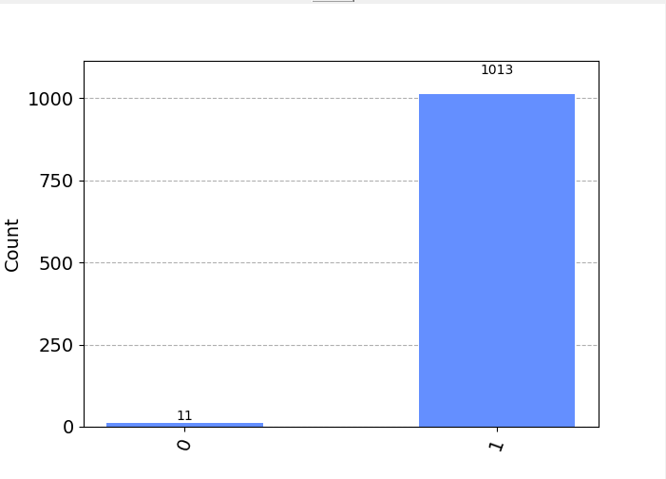
With a 1% error attributed to the Halfwave plate set at 45 degrees, 1% of the time our classical outcome is not “1”

Slide 29
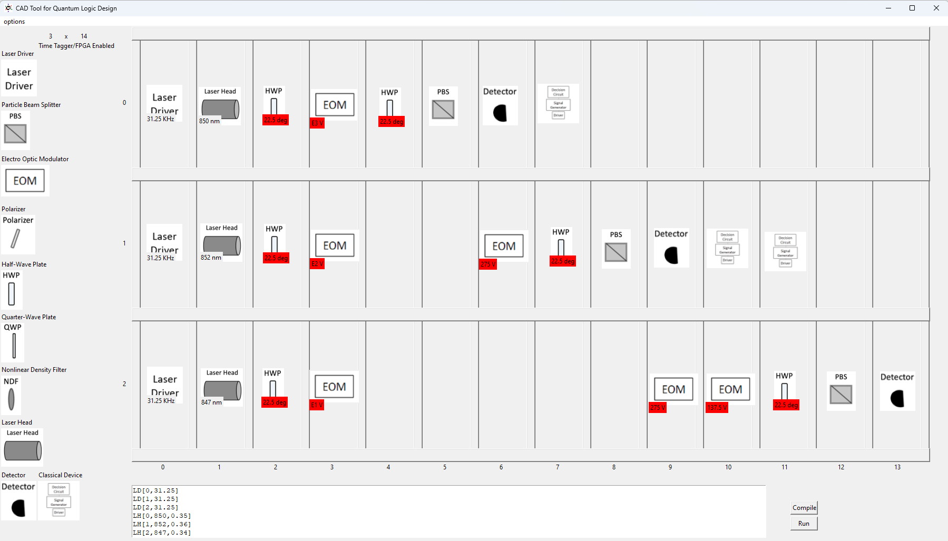
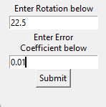
Using the PLDS to Build a realistic sQFT
A designer has set the physical devices in a manner that accounts for a realistic error model.

Slide 30
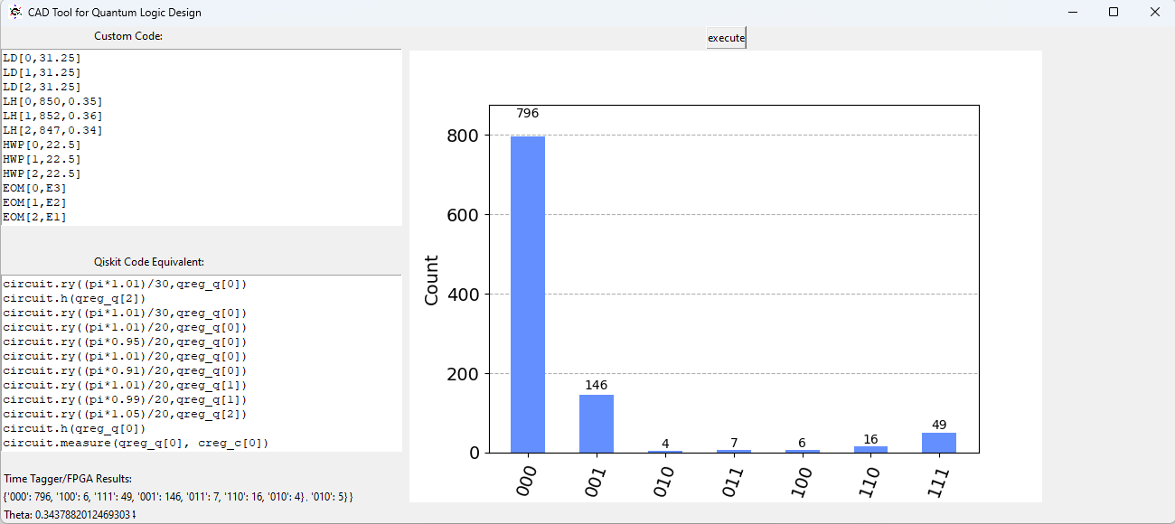
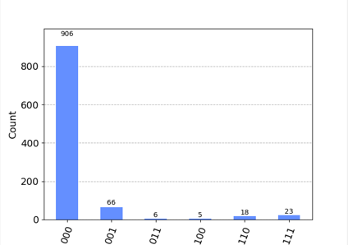
Below: unerrored sQFT results
Above: Executing the errored sQFT returns in a redistributed results histogram than presented in the errorless sQFT.

Slide 31
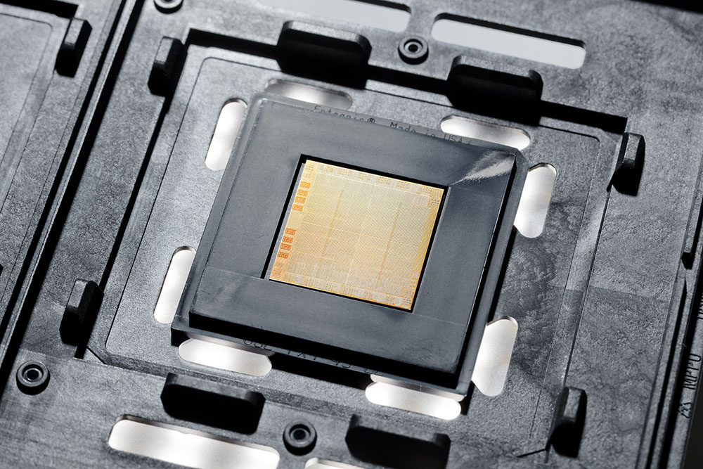
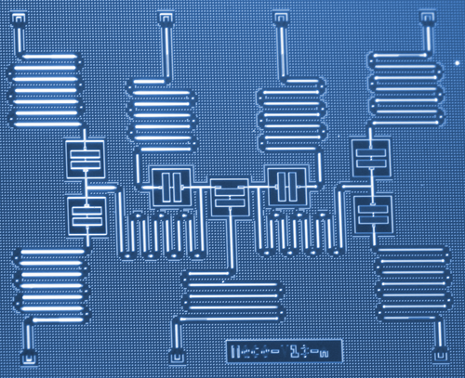
Future Work
A combination of classical and quantum devices
Conversions of circuits from one technology to another
Simulating the quantum architectures
Combining multiple special purpose architectures
AI & Machine Learning
Simulating and designing Quantum Integrated Chips
IBM POWER10 Chip [4]
IBM 7 Qubit Device [5]

Slide 32
[1] “The First Ever Photograph of Light as both a Particle and Wave." EPFL. Accessed: Oct. 26, 2023. [Online]. Available: https://actu.epfl.ch/news/the-first-ever-photograph-of-light-as-both-a-parti/#:~:text=Since%20the%20days%20of%20Einstein,particle%20and%20as%20a%20wave.
[2] “IBM’s First Quantum Data Center in Europe." IBM Research. Accessed: Oct. 26, 2023. [Online]. Available: https://research.ibm.com/blog/europe-quantum-datacenter-software
[3] “Free-Space Electro-Optic Modulators." Thor Labs. Accessed: Oct. 26, 2023. [Online]. Available: https://www.thorlabs.com/newgrouppage9.cfm?objectgroup_id=2729
[4] “IBM POWER10 Chip." IBM Newsroom. Accessed: Oct. 26, 2023. [Online]. Available: https://newsroom.ibm.com/media-quantum-innovation?keywords=quantum&l=100#gallery_gallery_0:21676
[5] “IBM 7 Qubit Device." IBM Newsroom. Accessed: Oct. 26, 2023. [Online]. Available: https://newsroom.ibm.com/media-quantum-innovation?keywords=quantum&l=100#gallery_gallery_0:19184

