Slide 1
6G An Ecosystem for Technology and Market Opportunities
Martijn Kuipers, INESC-INOV/Lusíada University - Lisbon, Portugal
12th CONASENSE Symposium
Munich, Germany
June 27-29, 2022

Slide 2
From 1G to 6G in 50 Years
A mobile telephone
GSM: digital communications
Packet Switching
The Streaming Era
The Internet of Things era
A Communications Ecosystem
Martijn Kuipers. INOV-INESC/Lusiada University
Notes:
Every generation introduces a key feature to lead the change.
About every 10 years, we have a new generation.
1G: This introduces the idea of cellular communications network
Absolutely revolutionary, with a few drawbacks:
Coverage was poor
Sound quality was low
No roaming support between various operators
No compatibility between systems: different systems operated on different frequency ranges
Calls weren’t encrypted: anyone with a radio scanner could drop in on a call.
2G Let’s go digital, which has the following advantages:
Voice calls were significantly clearer with less static and background crackling.
Voice calls were encrypted!
Text messages (SMS),
Picture and multimedia messages (MMS)
3: Using a standardized network protocol, users could access data from anywhere in the world (but roaming was expensive).
New features, such as:
video conferencing,
video streaming and
voice over IP
Smartphones changed the look and functionalities of our phones. iPhone and blackberry were released
These devices made the network feel slow
In order to increase the capacity, cell-sizes are getting smaller
Mobile phones are getting smaller …
4G 4G was first deployed in Stockholm, Sweden and Oslo, Norway in 2009 as the Long Term Evolution (LTE) 4G standard. It was subsequently introduced throughout the world and offered services, such as:
high-quality video streaming
fast mobile web access (up to 1Gbit/s for stationary users)
HQ video conferencing
Mobile devices needed to be specifically designed to support 4G, unlike for the 2G to 3G switch, which just required a 3G sim card.
5G IoT was touted as the next big digital revolution: Connecting billions of devices seamlessly across the globe.
5G latency between 1 and 10ms
5G data-rates up to 20Gbit/s (average 100Mbit/s)
5G is still being deployed and some countries haven’t even allocated the spectrum to operators.
Even smaller cell-size for dense urban areas.
5G is far more expensive and complicated to implement. Unlike previous generations like 3G and 4G that could piggyback off the infrastructure left by the previous generation.
5G requires many more base stations than 4G and these must be positioned closer together
Upgrading to 5G could collectively cost the tech industry over $200 billion (according to Bloomberg), and the benefits may not be worth the costs.

Slide 3
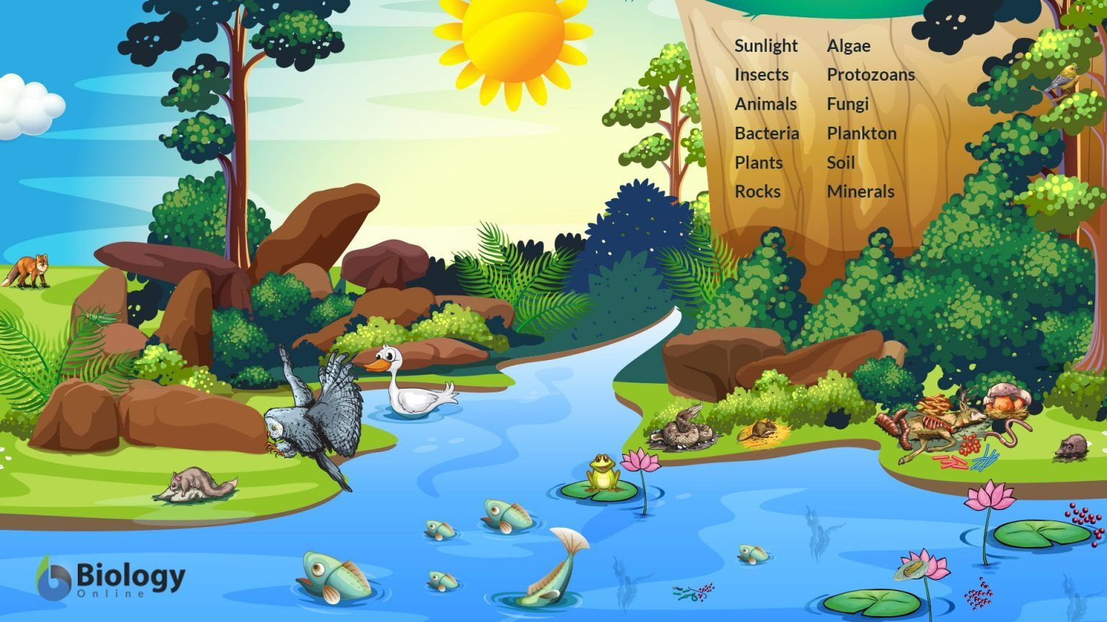
What is an ecosystem ?
An ecosystem is a geographic area where plants, animals, and other organisms, as well as weather and landscape, work together to form a bubble of life.
Martijn Kuipers. INOV-INESC/Lusiada University
12th CONASENSE Symposium Munich, Germany June 27-29, 2022

Slide 4
What is a 6G ecosystem ?
It’s a technological environment where all different communication systems live (happily) together:
3G, 4G, 5G
Lora
Sigfox
Fibre
Ethernet
Starlink
IoT systems
etc.
Martijn Kuipers. INOV-INESC/Lusiada University
12th CONASENSE Symposium Munich, Germany June 27-29, 2022

Slide 5
What is a 6G ecosystem ?
In an ecosystem we have to adapt to the interfaces
In 6G these interfaces must be open and standardized
This will be achieved through virtualization
Evolution of the traditional black-box base station architecture toward a virtualized gNB with a functional split, including the PHY split based on 3GPP 7.2x split.
Src: M. Polese, L. Bonati et al., “Understanding O-RAN: Architecture, interfaces, algorithms, security, and research challenges,” arXiv preprint arXiv:2202.01032, 2022.
Martijn Kuipers. INOV-INESC/Lusiada University
12th CONASENSE Symposium Munich, Germany June 27-29, 2022

Slide 6
What is so special about virtualization?
Cost savings—running multiple virtual environments on one piece of infrastructure means that you can drastically reduce your physical infrastructure footprint.
Agility and speed—Spinning up a VM is easy and quick
Lowered downtime—VMs are so portable and easy to move from one hypervisor to another on a different machine
Scalability—VMs allow you to more easily scale your apps by adding more physical or virtual servers to distribute the workload across multiple VMs
Security benefits— Because virtual machines run in multiple operating systems, all guests are isolated from each other
Martijn Kuipers. INOV-INESC/Lusiada University
12th CONASENSE Symposium Munich, Germany June 27-29, 2022

Slide 7
Virtualization for the Network Operator
In 6G, virtualization is not an option (unlike 5G)
It will use resource provisioning mechanisms based on self-managed reliable and trustworthy AI algorithms
Networks need to adapt dynamically to the required demand and requirements, and must do so without interrupting the service
This means that the classical overprovisioning approach for the network is no longer viable. (This is a good thing, overprovisioning costs a lot of money)
This requires new business-models and opportunities for the operators.
Invest in the network “as you grow” model
Martijn Kuipers. INOV-INESC/Lusiada University
12th CONASENSE Symposium Munich, Germany June 27-29, 2022

Slide 8
Virtualization for Industry/Academics
Virtualized cloud-services are easy to update
When a manufacturer has solved some bugs, this can be easily deployed
Virtualization isolates the various services, so it becomes easier to test out new ideas or technologies.
src: https://www.digitaljournal.com/tech-science/forget-5g-academia-aims-to-deliver-6g-communications/article
Martijn Kuipers. INOV-INESC/Lusiada University
12th CONASENSE Symposium Munich, Germany June 27-29, 2022

Slide 9
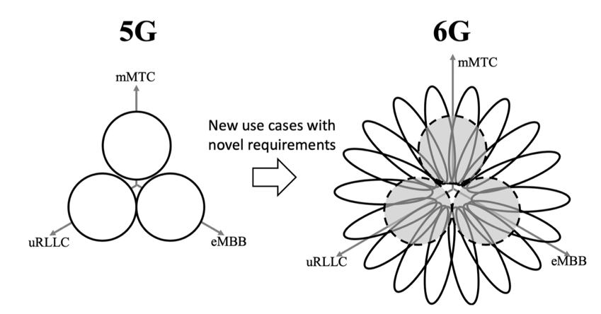
Virtualization for the End-Users
Virtualization allows for new (Virtual) Mobile Network Operators to enter the market
Virtualization allows operators to differentiate on use-cases
Now, at least we should get a decent choice
Martijn Kuipers. INOV-INESC/Lusiada University
12th CONASENSE Symposium Munich, Germany June 27-29, 2022

Slide 10
Virtualization for the End-Users
Perhaps we will have several contracts with (different) operators
A youtube contract (no more adds, flat fee)
A Virtual LAN “slice” contract so I can take the companies network home
A phone slice for work
A phone slice for personal connections
Etc.
We will become part of the 6G ecosystem, or
The 6G ecosystem will become part of our lives
Martijn Kuipers. INOV-INESC/Lusiada University
12th CONASENSE Symposium Munich, Germany June 27-29, 2022

Slide 11
6G – How to migrate from 5G?
20%
5G Legacy
5G
Parts of slice
40%
Smartphone
Parts of slice
30%
Automotive
Parts of slice
IoT Devices
10%
Parts of slice
5G Architecture
6G Architecture
Martijn Kuipers. INOV-INESC/Lusiada University
12th CONASENSE Symposium Munich, Germany June 27-29, 2022

Slide 12
6G - Beyond 6G
7G & Beyond
7G+
20%
Parts of slice
4%
5G Legacy
5G
Parts of slice
30%
Smartphone
Parts of slice
22%
Automotive
Parts of slice
IoT Devices
24%
Parts of slice
Martijn Kuipers. INOV-INESC/Lusiada University
12th CONASENSE Symposium Munich, Germany June 27-29, 2022

Slide 13
6G – Will there be 7G?
Any communication system can be implemented in 6G ecosystem
It is like a Rolling Release….
And if you really want, at some point you could market it as 7G or 8G (but it will still be 6G)
Martijn Kuipers. INOV-INESC/Lusiada University
12th CONASENSE Symposium Munich, Germany June 27-29, 2022

Slide 14
Conclusions
Ideally new and old, large and small area communication systems should be able to live together and (inter) communicate.
Virtualization is the cornerstone of 6G
It is the enabler of 6G
It is the reason we should invest(igate) in 6G
6G allows to “reset” our thinking and come up we new solutions
"The best way to predict the future is to invent it."
Alan Kay, XeroxPARC, Atari, Apple and a few more
Let’s invent 6G together
Martijn Kuipers. INOV-INESC/Lusiada University
12th CONASENSE Symposium Munich, Germany June 27-29, 2022

