Slide 1



Challenges in the Design of a Holographic Telepresence System - current outcomes from the implementation of a use case scenario
CONASENSE 2022 SYMPOSIUM
27 – 28 June, 2022
fortiss, Munich, Germany
Prof. Vladimir Poulkov
Faculty of Telecommunications
Technical University of Sofia
Sofia, Bulgaria

Slide 2
STRUCTURE of the TALK
1. Introduction – the HOLOTWIN system
2. Kinect Sensors Calibration
3. Environment Extraction
4. Human Body Reconstruction
5. Work in progress
6. Things done/Things to do &Challenges

Slide 3
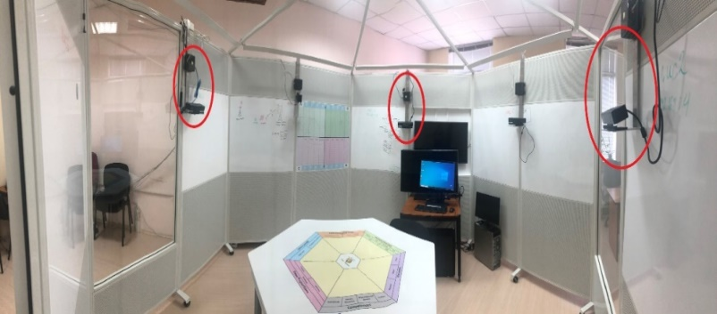
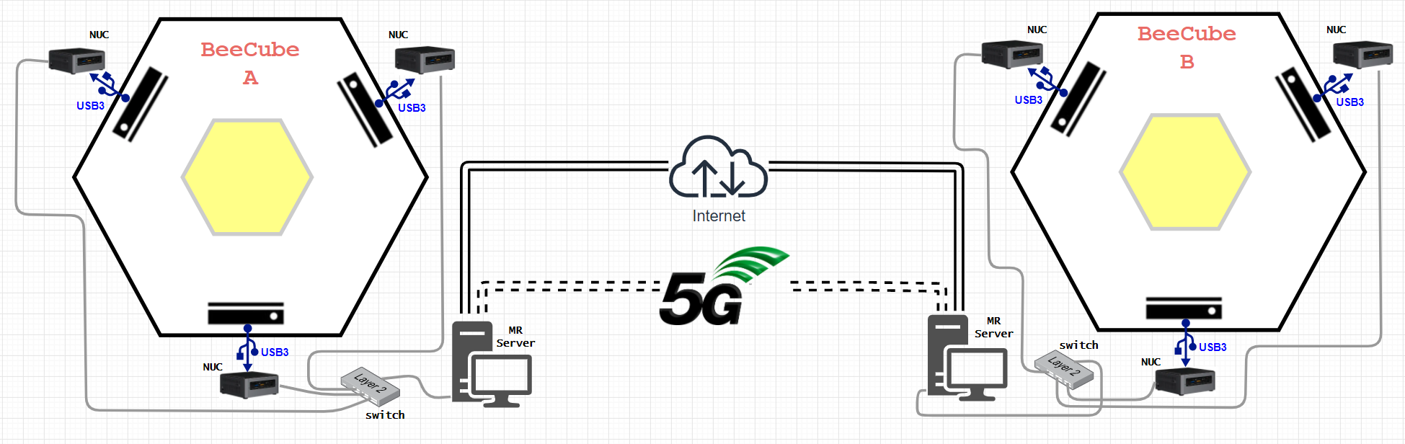
HOLOTWIN system

Slide 4
Kinect Sensors Calibration
The approach for calibration of the Kinect sensors network is based on using objects having a semantic meaning.
The goal is to avoid the necessity for dedicated markers, which complicates the calibration procedure.
The chosen objects with semantic meaning are part of the Bee Cube infrastructure, considered as a “controlled environment”.
The experimental results, show that such approach for semantic calibration delivers high accuracy results, similar to these of SotA algorithms used for the calibration of a network of Kinect sensors.

Slide 5
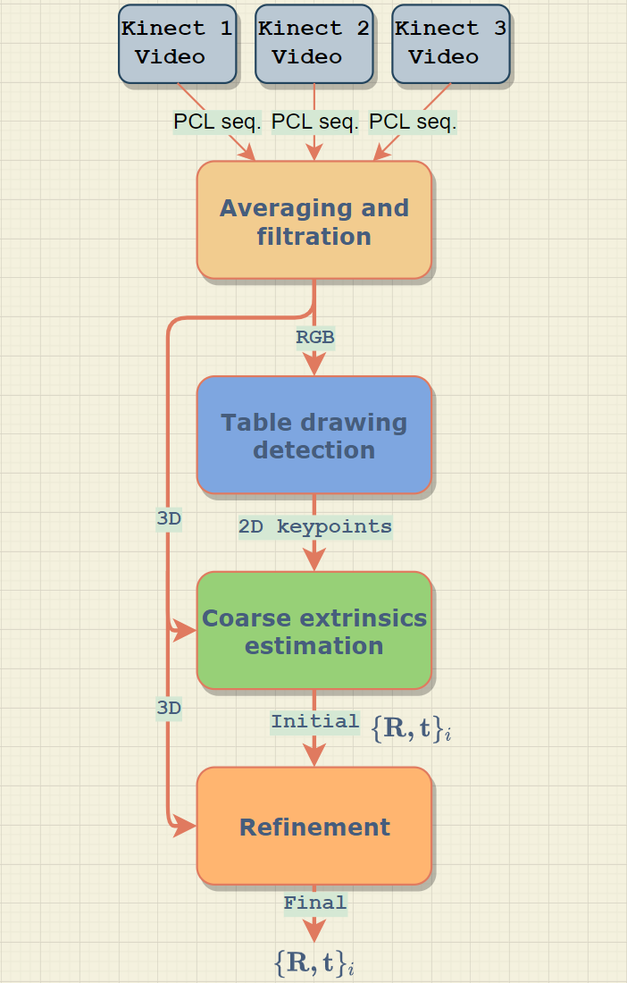
Kinect Sensors Calibration
The algorithm takes as input sequence of up to 50 frames of point cloud (PCL) data of a static scene from each Kinect sensor.
This data is initially filtered and averaged to remove noise and process missing 3D data. At the end, single frame of PCL data is delivered.
This frame is split into RGB and 3D data.
The RGB data is fed to the color scheme detection algorithm, which implements deep learning based object detection to extract the scheme.
Notes:
This initial estimation is further refined by the Refinement algorithm, which detects the BeeCube walls and performs global optimization in order to produce the final refined rotation and translation.

Slide 6
Kinect Sensors Calibration
The detection algorithm also extracts 2D keypoints. These key-points are further used for coarse extrinsics estimation.
This is done by 2D-3D projection of key-points and delivers initial estimation of the rigid transformations.
This initial estimation is further refined by Refinement algorithm, which detects the BeeCube walls and performs global optimization in order to produce the final refined rotation and translation.

Slide 7
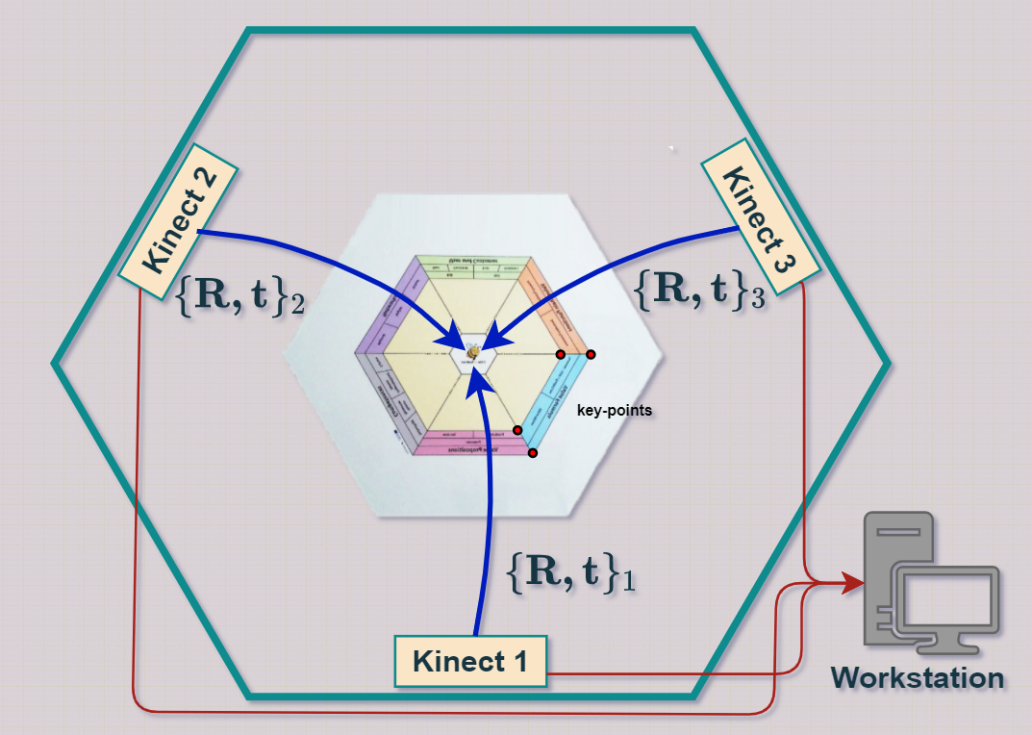
Kinect Sensors Calibration
Notes:
The detection algorithm also extracts 2D keypoints, four of them for example, marked with red circle with black border on the Fig. These key-points are further used for coarse extrinsics estimation. This is done by 2D-3D projection of key-points and delivers initial estimation of the rigid transformations.

Slide 8
Kinect Sensors Calibration
The color scheme printed on the table selected for semantic calibration has a distinctive edge, color gradients and corners, which makes it suitable for detection using modern deep learning algorithms.
One of the most popular and robust object detector is YOLO. It is a convolution neural network predicting class probabilities in its output layer, for each of the objects it was trained for.
However, the trained models available on the Internet are not suitable for this case. Furthermore, there are some variants of YOLO which might perform better over the others.
Because of this, evaluation and comparison of four YOLO variants was done and the one with best results is selected as color scheme detector.

Slide 9
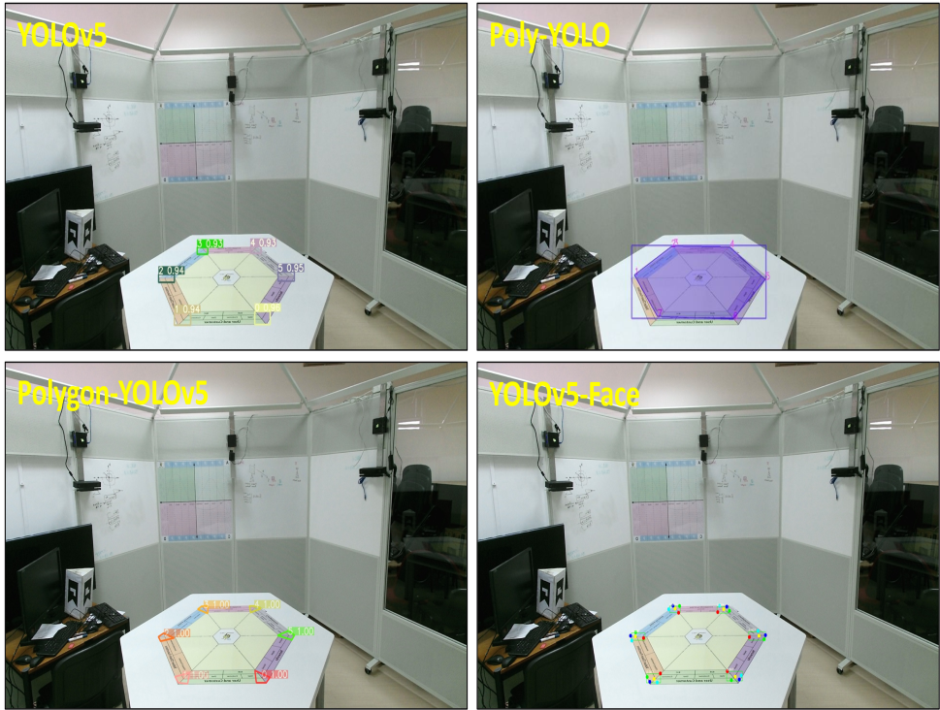
Kinect Sensors Calibration
Variant | Accuracy Artificial data,% | Accuracy Real data,%
YOLOv5 | 97 | 95
Poly-YOLO | 80 | 65
Polygon-YOLOv5 | 94 | 92
YOLOv5-Face | 98 | 87
YOLOv5 results are good enough for practical purposes, but they do not provide a 2D key-points coordinates. So they are used only for reference.
Example detections on real data of each YOLO variant

Slide 10
Kinect Sensors Calibration
Detected planes from two of the Kinect views.
Notes:
This initial estimation is further refined by the Refinement algorithm, which detects the BeeCube walls and performs global optimization in order to produce the final refined rotation and translation.

Slide 11
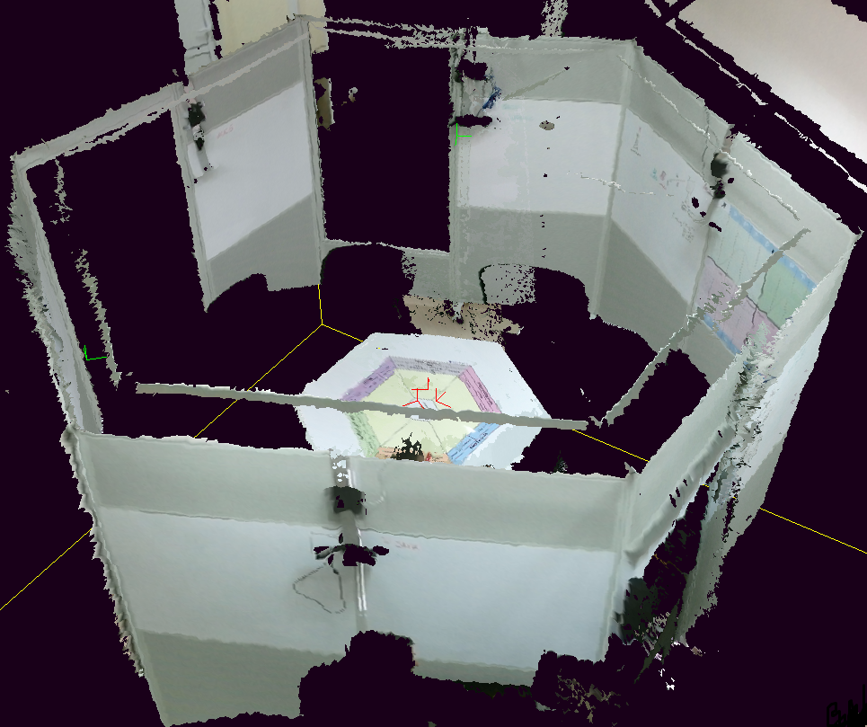
Kinect Sensors Calibration
This initial estimation is further refined by the Refinement algorithm, which detects the BeeCube walls and performs global optimization in order to produce the final refined rotation and translation.

Slide 12
BeeCube Environment Extraction
Basic idea and contribution:
• the development of a 3D scene extraction algorithm by using a plane detection method;
• a practical implementation of an experiment for testing of the proposed 3D scene extraction algorithm.

Slide 13
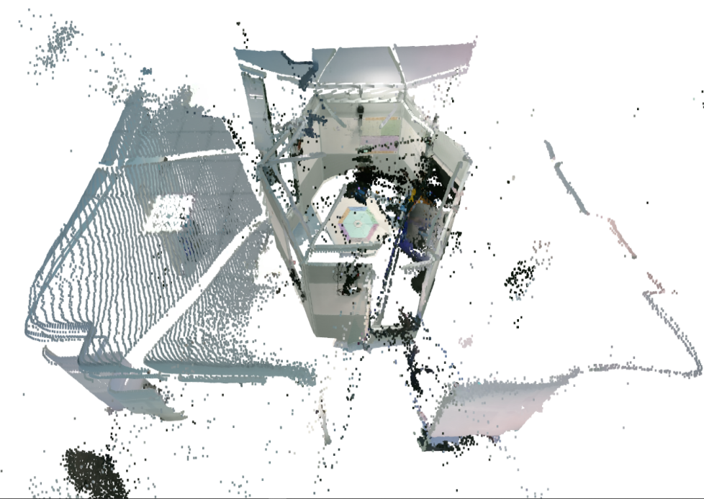
BeeCube Environment Extraction
Preliminary stage
Camera network calibration;
Data acquisition;
3D object reconstruction.
Registered 3D scene

Slide 14


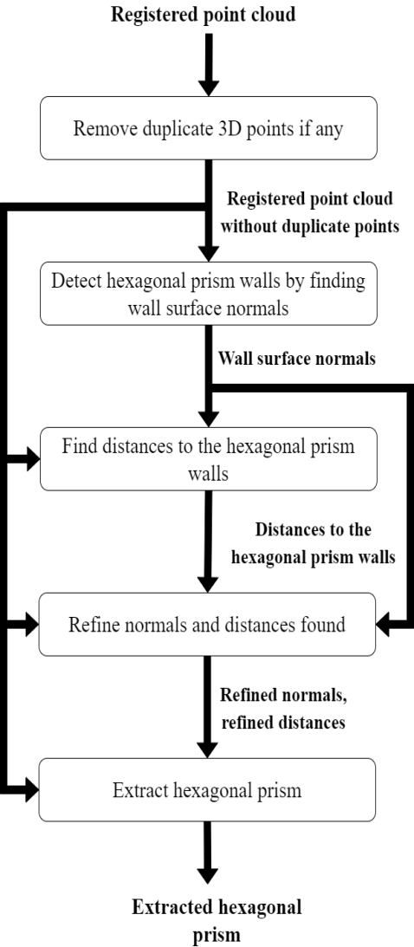

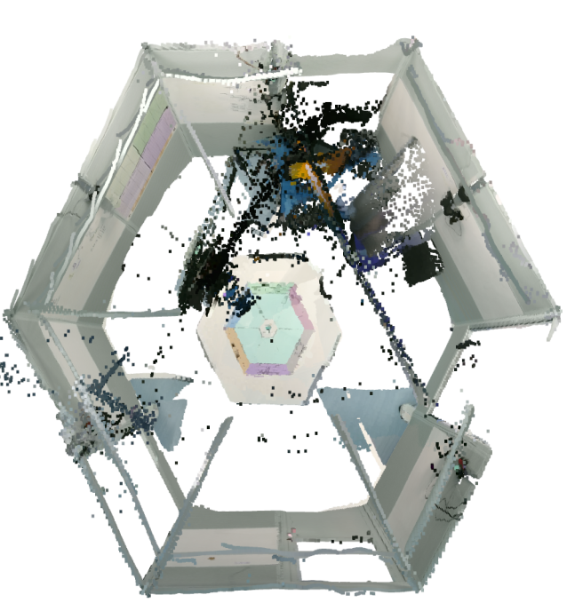
BeeCube Environment Extraction
Registered 3D scene
Environment extraction

Slide 15
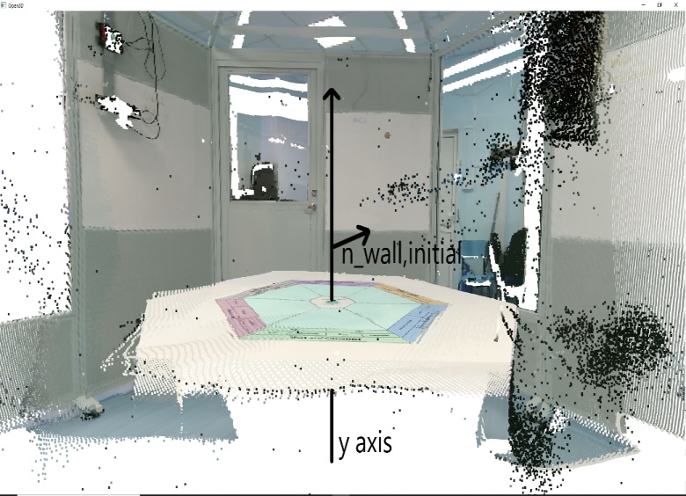
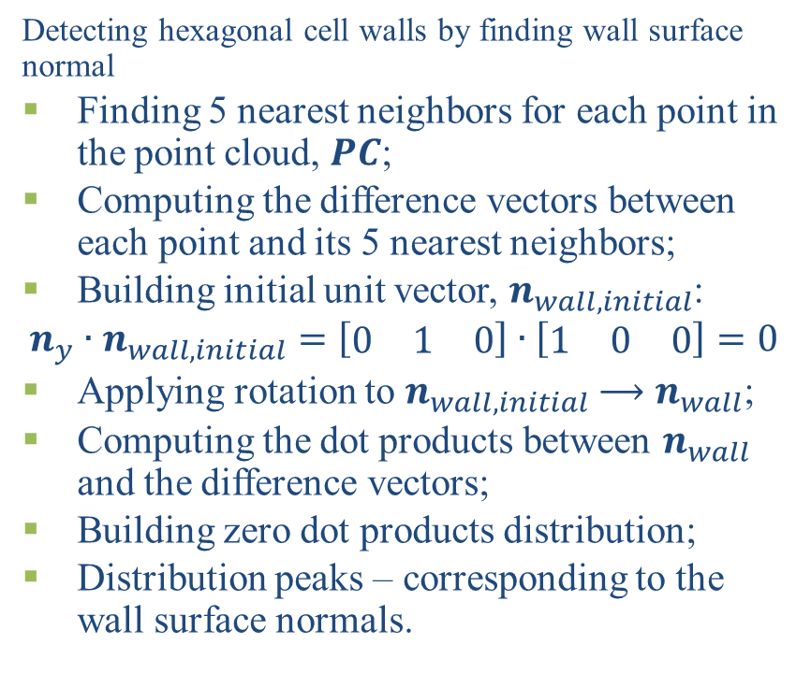
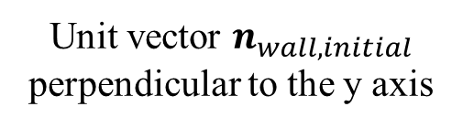
BeeCube Environment Extraction
Detecting hexagonal cell walls by finding wall surface normal
Finding 5 nearest neighbors for each point in the point cloud, $PC$;
Computing the difference vectors between each point and its 5 nearest neighbors;
Building initial unit vector, $n_{wall,initial}$:
$$n_{y}∙n_{wall,initial}=\left[\begin{matrix}0 & 1 & 0\end{matrix}\right]∙\left[\begin{matrix}1 & 0 & 0\end{matrix}\right]=0$$
Applying rotation to $n_{wall,initial}$ $⟶$ $n_{wall}$;
Computing the dot products between $n_{wall}$ and the difference vectors;
Building zero dot products distribution;
Distribution peaks – corresponding to the wall surface normals.
Unit vector $n_{wall,initial}$ perpendicular to the y axis

Slide 16
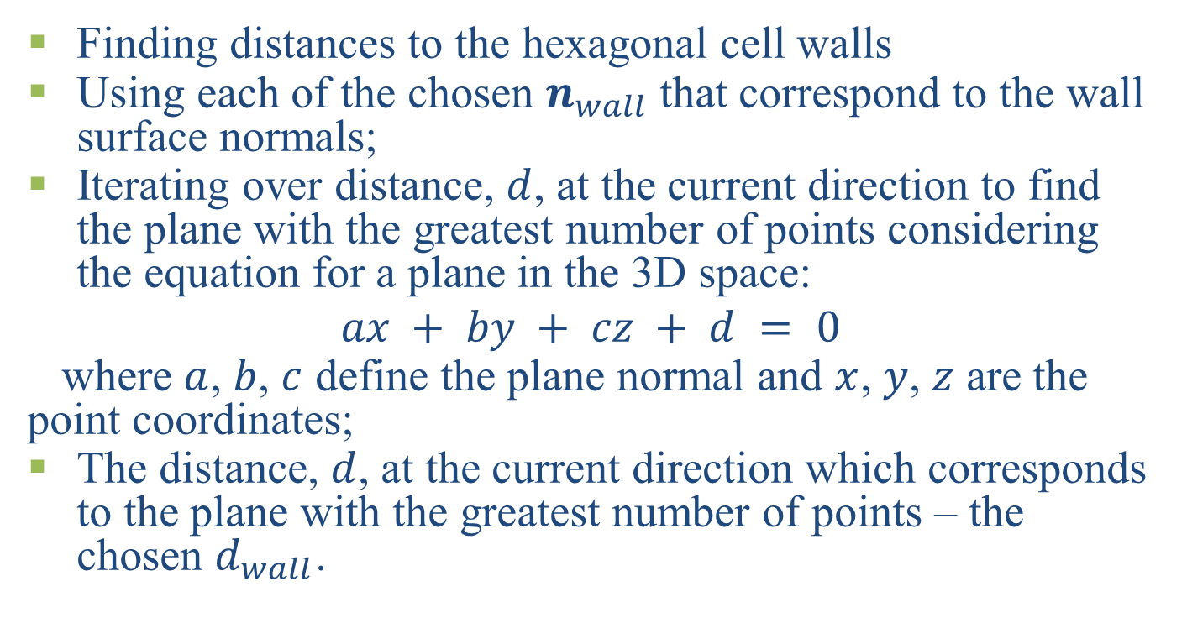
BeeCube Environment Extraction
Finding distances to the hexagonal cell walls
Using each of the chosen $n_{wall}$that correspond to the wall surface normals;
Iterating over distance, $d$, at the current direction to find the plane with the greatest number of points considering the equation for a plane in the 3D space:
$$ax + by + cz + d = 0$$
where $a$, $b$, $c$ define the plane normal and $x$, $y$, $z$ are the point coordinates;
The distance, $d$, at the current direction which corresponds to the plane with the greatest number of points – the chosen $d_{wall}$.

Slide 17
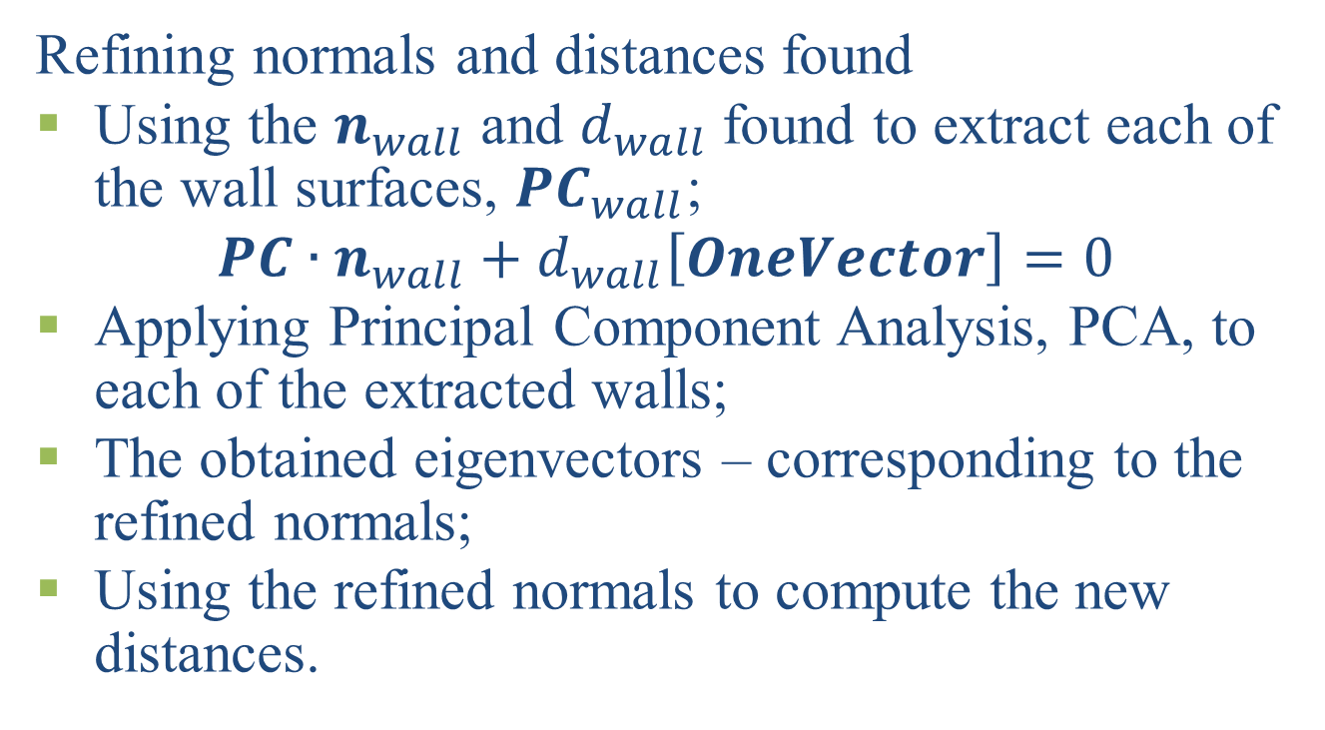
BeeCube Environment Extraction
Refining normals and distances found
Using the $n_{wall}$ and $d_{wall}$ found to extract each of the wall surfaces, ${PC}_{wall}$;
$$PC∙n_{wall}+d_{wall}\left[OneVector\right]=0$$
Applying Principal Component Analysis, PCA, to each of the extracted walls;
The obtained eigenvectors – corresponding to the refined normals;
Using the refined normals to compute the new distances.

Slide 18
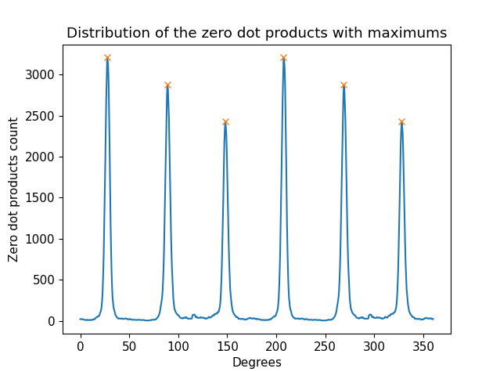
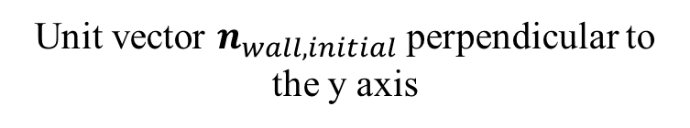
BeeCube Environment Extraction
Experimental results
Zero dot products distribution
Unit vector $n_{wall,initial}$ perpendicular to the y axis

Slide 19
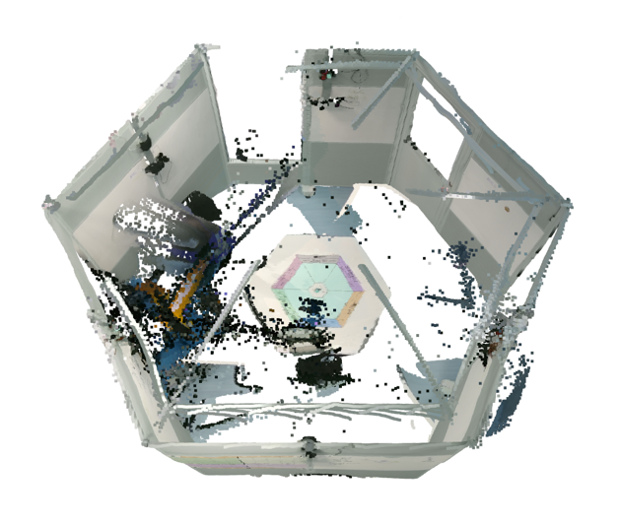

BeeCube Environment Extraction
Experimental results
Extracting the 3D scene using wall normals and distances found

Slide 20
BeeCube Environment Extraction
To do:
Mitigating the noise inside the hexagonal cell;
Considering the case where a planar surface is located in front of or behind a wall;
Algorithm performance on various scenes, different from the one investigated in this work;
Reduction of the computational time.

Slide 21
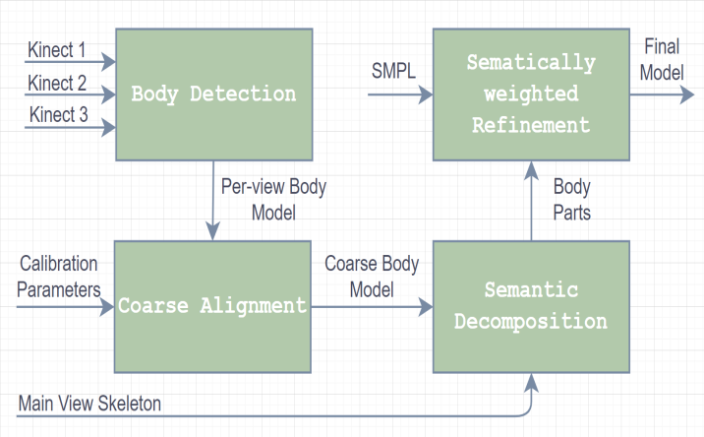
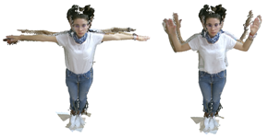
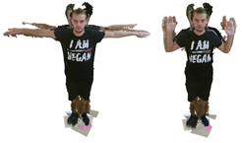
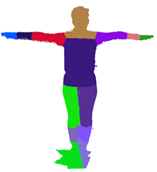
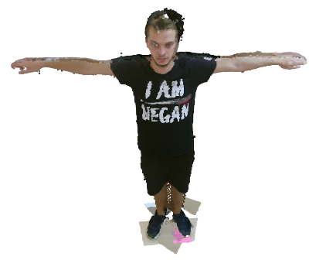
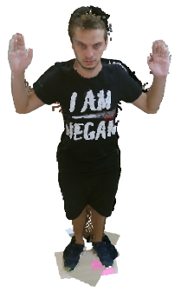
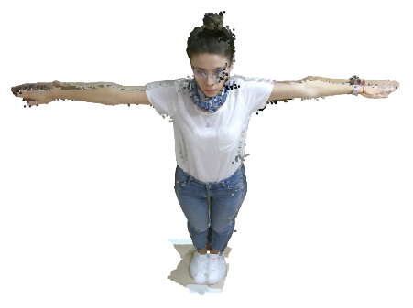
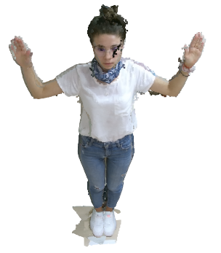
Human Body Reconstruction

Slide 22
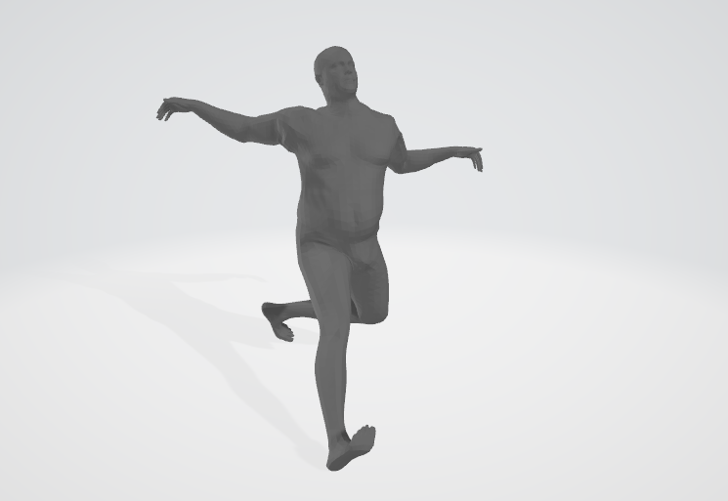
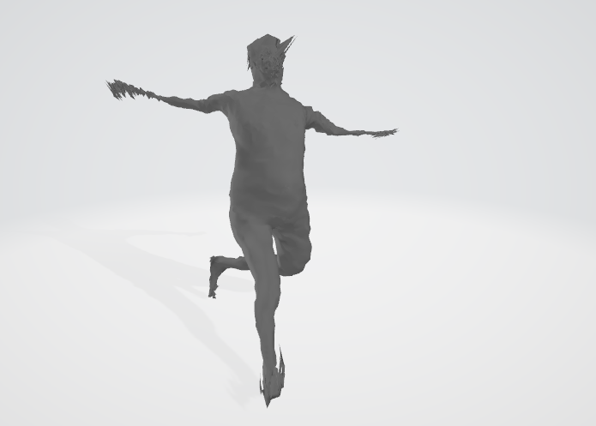
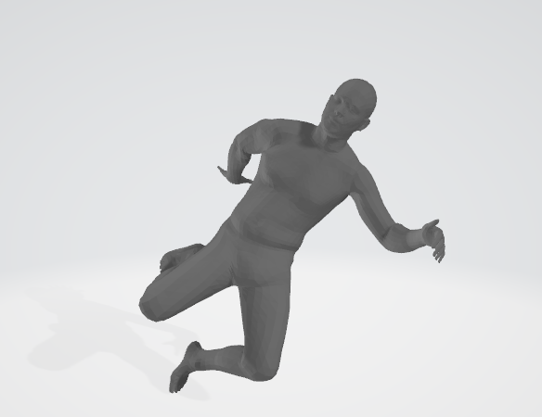
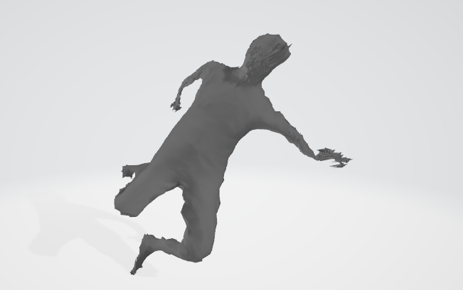
Deep Body Compression – work in progress

Slide 23
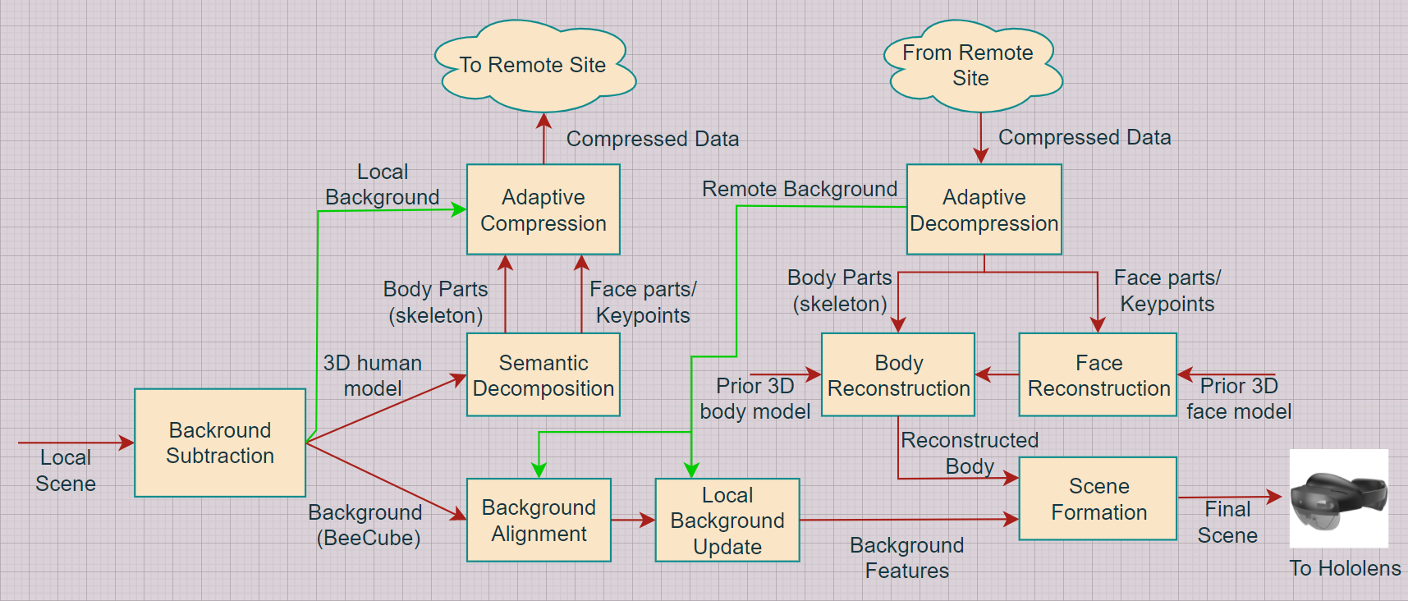
Overall algorithm – work in progress

Slide 24
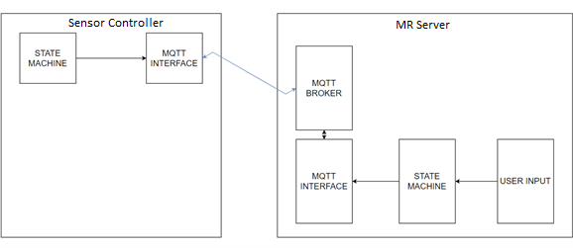
Communications

Slide 25
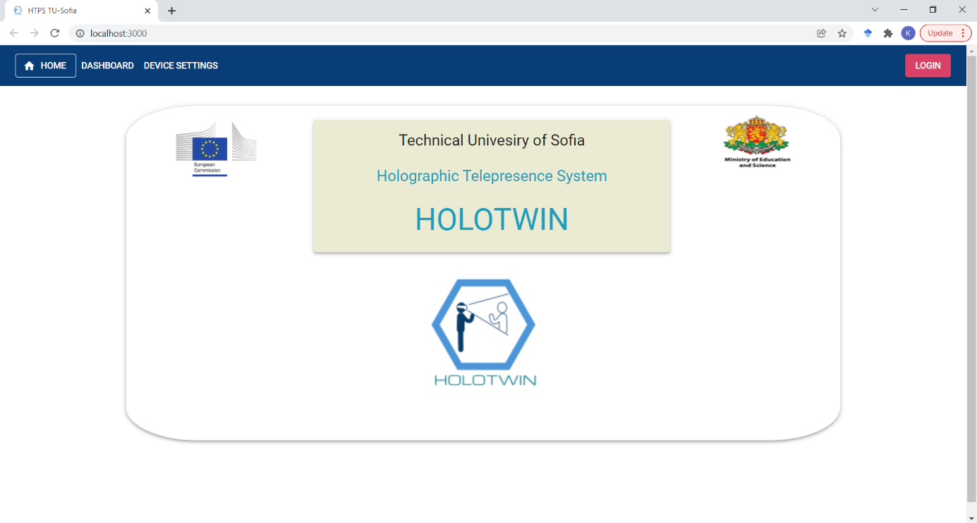
Web Interface (1)

Slide 26
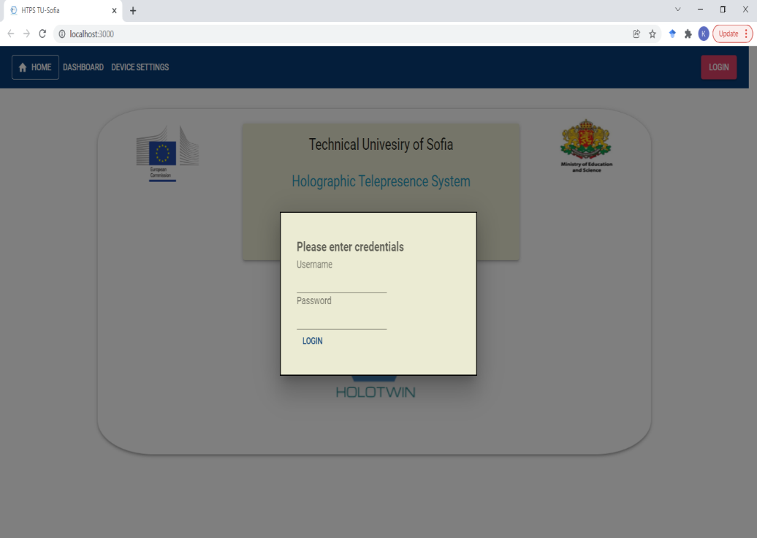
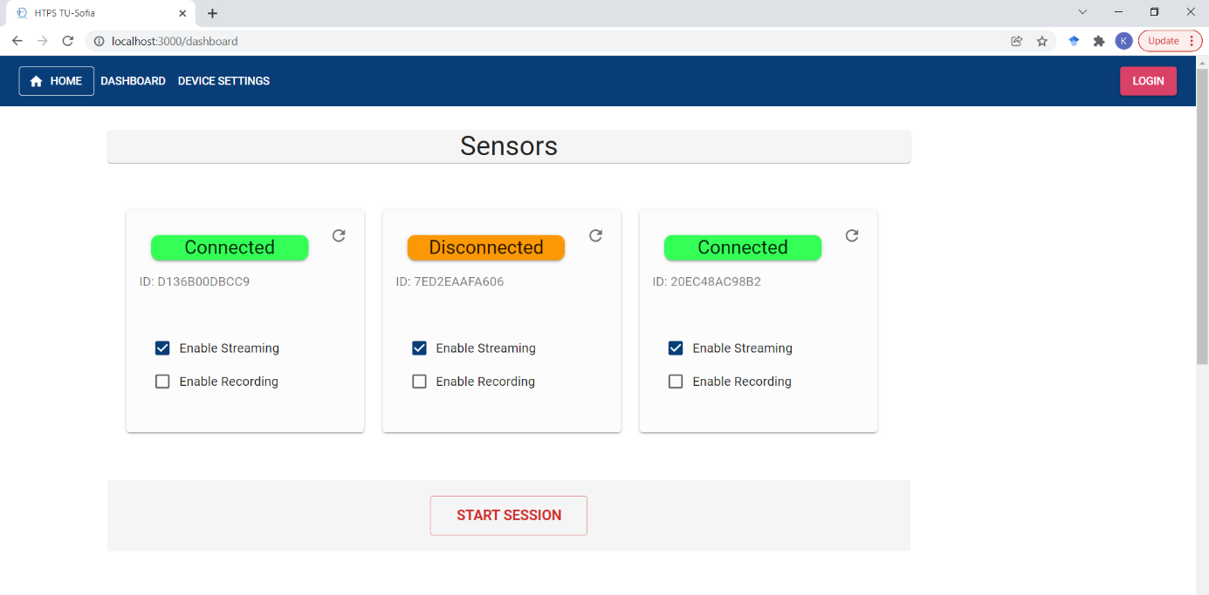
Web Interface (2)

Slide 27
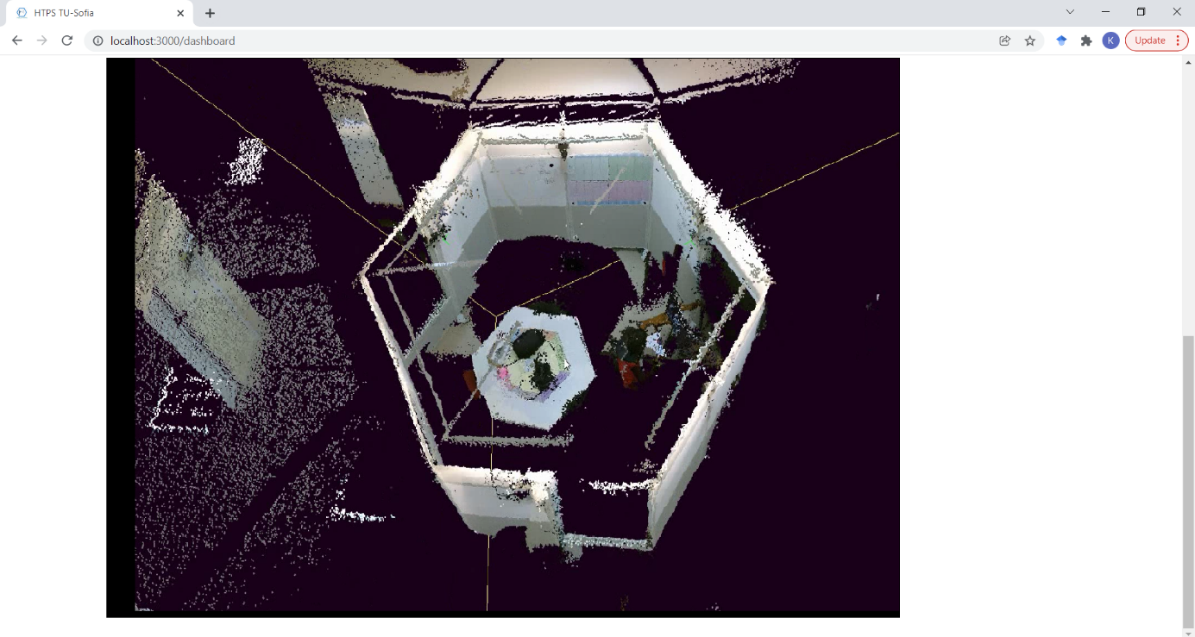
Web Interface (3)

Slide 28
Things Done
Software:
  Kinect driver
  Local connectivity and identification
  Basic web interface
  Prototype Hololens application
Algorithms
  Camera calibration
  Scene reconstruction including meshing
  Scene extraction – extracting relevant parts from the scene

Slide 29
Things To Do & Challenges
Software:
  Improvements of the web interface
  General software improvements
  Hololens application improvement
  Real time remote side connectivity and stream synchronization
Algorithms
  3D scene compression
  Remote and local scene alignment (mixing the realities)

Slide 30
REFERENCES
A. Manolova, K. Tonchev, V. Poulkov, S. Dixir, and P. Lindgren, “Context-aware holographic communication based on semantic knowledge extraction.” Wireless Personal Communications, pp. 1–13, 2021.
K. Tonchev, I. Bozhilov, R. Petkova, V. Poulkov, A. Manolova, and P. Lindgren, “Implementation requirements and system architecture for mixed reality telepresence application scenario,” in 2021 24th International Symposium on Wireless Personal Multimedia Communications (WPMC), 2021, pp. 1–6.
K. Tonchev, A. Manolova, N. Neshov, and V. Poulkov, “Rgb-d sensors extrinsic calibration in controlled environment,” in 11th IEEE IDAACS 2021, vol. 2. IEEE, 2021, pp. 730–735.
Krasimir Tonchev, Nikolay Neshov, Radostina Petkova, Agata Manolova, Vladimir Poulkov. Kinect sensors network calibration in controlled environment based on semantic information. Proceedings of the IEEE International Black Sea Conference on Communications and Networking. June 2022. To appear.
Radostina Petkova , Krasimir Tonchev , Agata Manolova , Vladimir Poulkov. 3D scene extraction using plane detection algorithm. Proceedings of the IEEE International Black Sea Conference on Communications and Networking. June 2022. To appear.

Slide 31
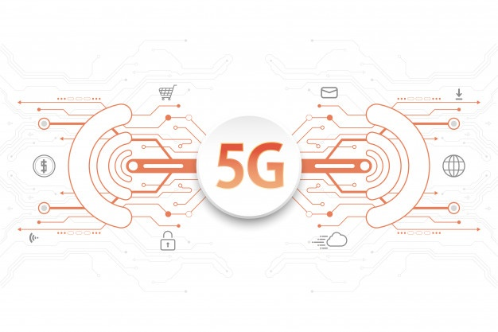
THANK YOU!

